Slide 1
CIS9660: Data Mining for Business Analytics 6. Clustering
(Foster Provost and Tom Fawcett. 2013. Data Science for Business: What you need to know about data mining and data-analytic thinking. O'Reilly Media. Chapter 6)

Slide 2
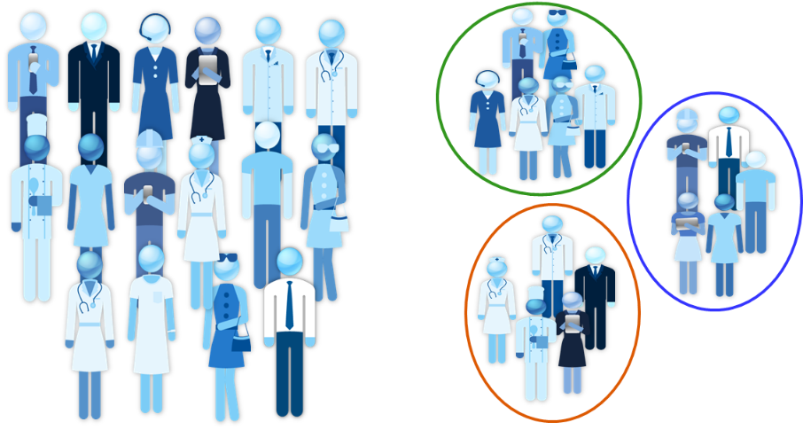
What is Clustering
Clustering or cluster analysis is the art of finding groups based on similarity in data
Observations within a group should be similar
Observations from different groups should be dissimilar

Slide 3
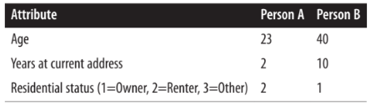
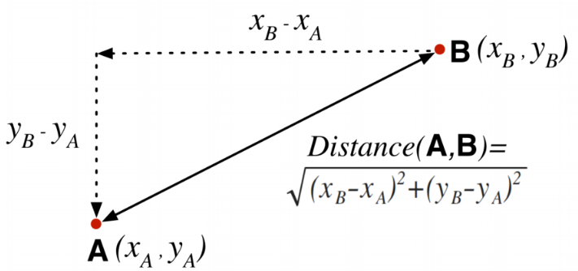
Similarity and Distance
If we represent each object as a feature vector, the closer two objects are in the space defined by the features, the more similar they are
For example, consider two instances from a simplified credit application domain.
These data items have multiple attributes. A good place to begin is with measurements of distance from basic geometry.

Slide 4


Similarity and Distance
When an object is described by n features, n dimensions(d1, d2, …, dn), the general equation for Euclidean distance in n dimensions is:
Recalling person A and B, above, their Euclidean distance is:
How can we interpret the distance of 18.8?

Slide 5
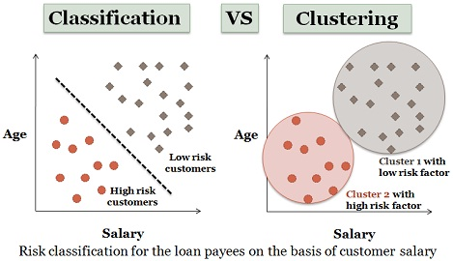
What is Cluster Analysis?
Classification
Observations are labeled based on a target variable (e.g., default vs. not default)
The goal is to find a rule that can predict labels of new observations
Supervised learning
Clustering
Observations are not labeled, viz. don’t know which group one observation belongs to before the analysis
Goal is to find clusters in which similar observations are grouped together
Unsupervised learning

Slide 6
What Cluster Analysis Is NOT
Classification
(like Decision Trees)
People place items into categories
Simple categorization by attributes
Dividing students into groups by last name
The clusters must be learned from the data, not from external specifications.
Creating the “buckets” beforehand is categorization, but not clustering.

Slide 7
What is Cluster Analysis?
Examples
Marketing (Market Segmentation)
Do customers naturally fall into different groups?
Industry analysis
Finding groups of similar firms based on profitability, growth rate, market size, products, etc.
Political forecasting
Group neighborhoods by demographics, lifestyles and political view
Biology
Finance
Group similar plants into species
Define groups of similar stocks based on financial characteristics, and select stocks from different groups to create balanced portfolios

Slide 8
How to Group These Data Points?
Questions:
How many clusters could there be?
Which data points are similar? How do you define “similar”?
How to evaluate your clustering results?

Slide 9
Clustering Algorithms
One commonly used method is called K-Means clustering analysis.
“K” stands for the number of clusters
How can we choose a right “K”?
The idea is to assign each observation to one and only one cluster based on the similarity among observations
How to determine similarity among observations?
Tradeoff between having more clusters (better focus within each cluster) and having too few clusters
Some special cases: k = 1, k = n

Slide 10
K-Means Algorithm
K-Means cluster-analysis methods
In K-Means clustering, the user begins with specifying the number of clusters, k
Then k points are chosen at random as cluster centers.
All instances are assigned to their closest cluster center according to the ordinary Euclidean distance metric.
Next the centroid, or mean, of the instances in each cluster is calculated—this is the “means” part. These centroids are taken to be new center values for their respective clusters.
Finally, the whole process is repeated with the new cluster centers.
Iteration continues until the same points are assigned to each cluster in consecutive rounds, at which stage the cluster centers have stabilized and will remain the same forever.

Slide 11
K-Means Algorithm
Define the value of K
Randomly select K points as initial centroids
Assign each point to the cluster with the closest centroid
Yes
Re-compute the centroid of each cluster
No
Did the center change?
DONE!

Slide 12
How to Choose the Number of Clusters (K)
Can be determined by external reasons
In many cases, there’s no single answer…
But here’s what we can do:
Try out different possibilities and see which is best
Make sure the clusters are describing distinct groups (separation).
Make sure that the range of values on each variable within a cluster is not too large to be useful (cohesion).
An Interaction Demonstration:
http://alekseynp.com/viz/k-means.html

Slide 13
How to Choose the Number of Clusters (K):
Example of Poor Initialization
This may “work” mathematically but the clusters don’t make much sense.

Slide 14
How to Choose the Number of Clusters (K):
Clusters Can Be Ambiguous
How many clusters?
6
2
4
The difference is the threshold you set.
How distinct must a cluster to be it’s own cluster?
adapted from Tan, Steinbach, and Kumar. Introduction to Data Mining (2004)

Slide 15
K-Means Demonstration
Here is the initial data set

Slide 16
K-Means Demonstration
Choose K points as initial centroids

Slide 17
K-Means Demonstration
Assign data points according to distance

Slide 18
K-Means Demonstration
Recalculate the centroids
To calculate the centroid from the cluster table just get the position of all points of a single cluster, sum them up and divide by the number of points.

Slide 19
K-Means Demonstration
And re-assign the points

Slide 20
K-Means Demonstration
And keep doing that until you settle on a final set of clusters

Slide 21
Data Preparation Before Clustering - Know Your Observations
Real-value attributes/variables
e.g., salary, height
Binary attributes
e.g., gender (M/F), has_cancer(T/F)
Nominal (categorical) attributes
e.g., marital status (single, married, separated, divorced, or widowed, etc.)
Ordinal/Ranked attributes
e.g., military rank (soldier, sergeant, lutenant, captain, etc.)
Variables of mixed types
multiple attributes with various types

Slide 22
Data Preparation: Remove Outliers
Outliers are extreme values that deviate from other observations on data
We need to remove outliers which can skew the cluster centroids
They don’t represent the population anyway
In some applications, we use clustering to discover outliers (outlier analysis)

Slide 23
Data Preparation: Normalize the Data
Sometimes observations have heterogeneous attributes
For example, income between $0-1 billion versus age between 0-100
The distance metric may consider 10 dollars of income difference to be as significant as ten years of age difference
Normalizing the variables is important to keep a variable with high variability from dominating the cluster analysis
Be careful! In some cases, normalizing variables hides the true groupings present in the data
Normalization: adjusts for differences in scale
Subtracting with the average and dividing by the standard deviation
This transform data into a “standard” scale
New average = 0
New standard deviation = 1

Slide 24
Normalization: A Numeric Example
If we have 5 employees’
income values:
The normalized income values would be:
Income
50,000
60,000
70,000
80,000
90,000
Income
-3.16
-1.58
0
1.58
3.16
Average: 70,000
Standard deviation: 6324
New average: 0
New standard deviation: 1
Normalize 1st employee’s income: (50,000-70,000)/6324= -3.16
Normalize 2nd employee’s income: (60,000-70,000)/6324= -1.58

Slide 25
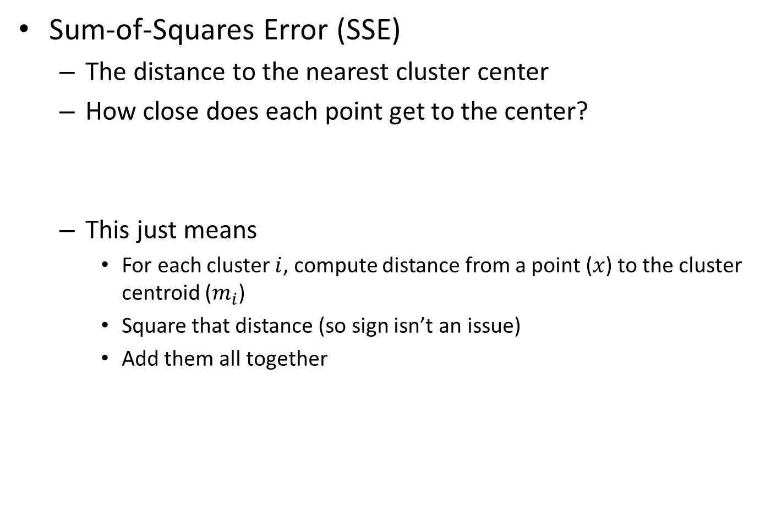
Evaluating K-means Clusters
Sum-of-Squares Error (SSE)
The distance to the nearest cluster center
How close does each point get to the center?
This just means
For each cluster $i$, compute distance from a point ($x$) to the cluster centroid ($m_{i}$)
Square that distance (so sign isn’t an issue)
Add them all together
SSE is always non-negative (>=0)

Slide 26
Within-Cluster SSE
Within-cluster SSE measures cohesion – how tightly grouped each cluster is.
Cluster 1
Cluster 2
3
3.3
1
1.3
1.5
2
SSE₁ = 1² + 1.3² + 2² = 1 + 1.69 + 4 = 6.69
SSE₂ = 3² + 3.3² + 1.5² = 9 + 10.89 + 2.25 = 22.14

Slide 27
Within-Cluster SSE
Considerations
Lower individual within cluster SSE = a better cluster
Lower total within cluster SSE = a better set of clusters
More clusters will reduce within-cluster SSE
Reducing within-cluster SSE increases cohesion
(we want it)

Slide 28
Between-Cluster SSE
Between-cluster SSE measures separation – distance between centroids
You’d want to maximize SSE between clusters
Increasing between-cluster SSE increases separation
(we want it)
Cluster 1
Cluster 5

Slide 29
Trade-off: Cohesion versus Separation
2 clusters
6 clusters
versus
More clusters → higher cohesion
More clusters → lower separation
(lower within cluster SSE)
(lower between cluster SSE)

Slide 30
The Keys to Successful K-Means Clustering
Choose the right number of clusters so that we have:
No easy way to do this
Trial-and-error, knowledge of the problem, and looking at the output
High cohesion
Low within-cluster SSE
High separation
High between-cluster SSE

Slide 31
Limitations of K-Means Clustering
The result is locally optimal, and there is no guarantee that it is globally optimal
It is almost always infeasible to find globally optimal clusters
To increase the chance of finding a global minimum people often run the algorithm several times with different initial choices and choose the best final result—the one with the smallest total squared distance.
The final clusters are quite sensitive to the initial cluster centroids
Completely different arrangements can arise from small changes in the initial random choice.
K-Means gives unreliable results when
Clusters vary widely in size
Clusters vary widely in density
Clusters are not in rounded shapes
The data set has a lot of outliers

Slide 32
Other Clustering Algorithms: Hierarchical cluster-analysis
Hierarchical cluster-analysis: A method seeks to build a hierarchy of clusters.
Agglomerative: A "bottom-up" approach: each observation starts in its own cluster, and pairs of clusters are merged as one moves up the hierarchy.
Start with the points as individual clusters
At each step, merge the closest pair of clusters until only one cluster (or k clusters) left
Divisive: A "top-down" approach: all observations start in one cluster, and splits are performed recursively as one moves down the hierarchy.
Start with one, all-inclusive cluster
At each step, split a cluster until each cluster contains a point (or there are k clusters)

Slide 33
Other Clustering Algorithms: Hierarchical cluster-analysis
Ch. 17
Advantage of hierarchical clustering：
It allows the data analyst to see the groupings—the “landscape” of data similarity—before deciding on the number of clusters to extract.
As shown by the horizontal dashed lines, the diagram can be cut across at any point to give any desired number of clusters.
One of the best-known uses of hierarchical clustering is in the “Tree of Life”, a hierarchical phylogenetic chart of all life on earth.
animal
vertebrate
invertebrate
fish reptile amphib. mammal worm insect crustacean

Slide 34
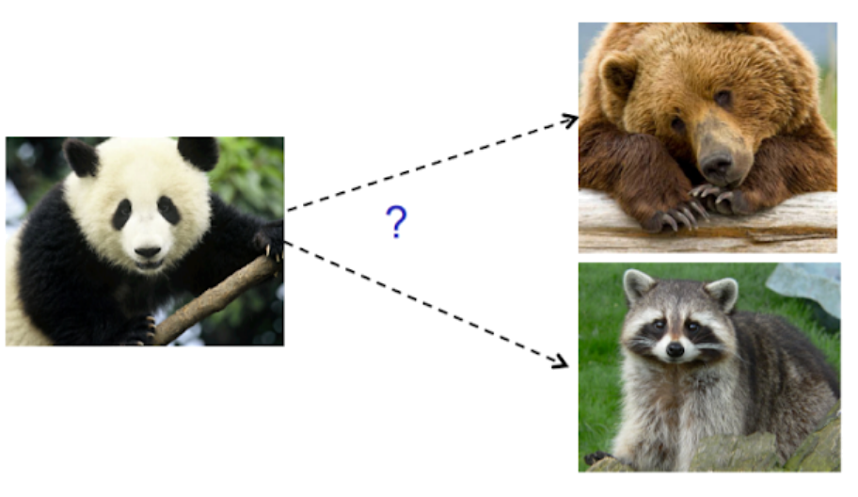
Applications of Agglomerative clustering algorithm
Are giant pandas closer to bears or racoons?
https://towardsdatascience.com/hierarchical-clustering-and-its-applications-41c1ad4441a6

Slide 35
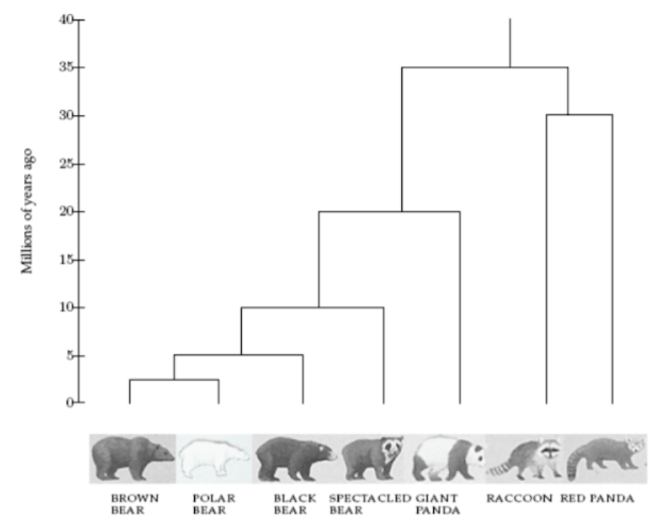
Applications of Agglomerative clustering algorithm
https://towardsdatascience.com/hierarchical-clustering-and-its-applications-41c1ad4441a6

Slide 36
Evaluating If Our Clusters Are Good
“Good” means
Meaningful
Useful
Provides insight
How to interpret the clusters?
Obtain summary statistics
Visualize the clusters
See examples in the lab
Subjective and depending on expectations

Slide 37
Summary
What is cluster analysis?
What is the difference between clustering and classification?
When to use this technique (applications)?
What is the basic idea behind K-means clustering algorithm?
K: the number of clusters
Centroid
How to prepare data before clustering?
Removing outliers
Normalization
Sum of squares errors (SSE) – to measure distance
Within-cluster SSE: Cohesion
Between-cluster SSE: Separation
What is the basic idea behind hierarchical clustering algorithm?
What is a good clustering?

